Slide 1
AI-Systems Distributed Deep Learning (Part I) (294-162)
Amir Gholami & Joseph E. Gonzalez

Slide 2
Acknowledgments
Many slides from Prof. Kurt Keutzer, Pallas Group

Slide 3
Agenda for Today
1:10-2:00: Preliminary Lecture on Parallel Training
2:00-2:45: PC Meeting Discussions
2:45-3:00: Break
3:00-4:00: Guest Lecture by Prof. Sophia Shao

Slide 4
Remaining slides from Last Lecture

Slide 5
Designing an accelerator
1) Accelerators are Only the First 80% of the Problem
The other 80%: Full system design
The remaining 200%: SW development
2) HW design shouldn’t be about what can be built, rather what can be programmed
Stay tuned for the Lecture on AI Frameworks
3) Deploy at scale? Today’s lecture
Research Challenges (if you are interested definition checkout EE 290 course by Prof. Shao) Abstraction Levels, DSLs Coarse Grained vs Fine Grain Acceleration Programming Languages, Programming Models Optimization Techniques, Runtimes
HW Definition Languages Co-Design Methodology Datacenter / Design, Deployment Datacenter / Heterogeneity
Naveen Kumar (Google)

Slide 6
The right dataflow, precision, and many other parameters heavily depend on the workload. If you were to design a HW today, it would at least take ~2years for its tape out, with a cost of ~$500M (estimate for 3nm)
It must remain relevant through ~5 years to justify the huge upfront investment
What do you think is the right workload for the future to bet on?

Slide 7
Distributed Deep Learning

Slide 8
Objectives For Today
Data Parallel Training and its Challenges
Communication Complexity Analysis
Model Parallel Training (Next Lecture)
Memory Efficient Methods for Training Large Models (Next Lecture)

Slide 9
Distributed Training: What is it? & Why?
Distributed Training* ~ Training across multiple devices
Different local and remote memory speeds / network
Why do we need distributed training?
Additional memory (memory bandwidth) for larger model
“Need” to store weights + activations
Faster training by leveraging parallel computation
Reduce or eliminate data movement
Privacy → Federated Learning
Limited bandwidth to edge devices
(stay tuned for 04/25 lecture)
*Very simplified definition.

Slide 10
Training Large Models
Beyond single chip memory
Amir Gholami, Zhewei Yao, Sehoon Kim, Michael W. Mahoney, Kurt Keutzer, AI and Memory Wall, Riselab Medium Blogpost, 2021.
Notes:
Baidu: Distributed Hierarchical GPU Parameter Server for Massive Scale Deep Learning Ads Systems, W. Zhao et al.

Slide 11
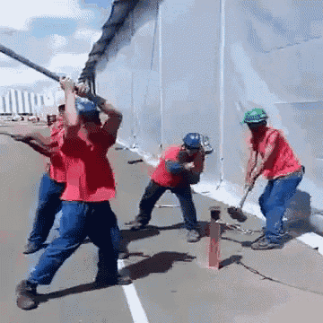
Faster Processing
Scale Training to Multiple Processes
Amir Gholami, Zhewei Yao, Sehoon Kim, Michael W. Mahoney, Kurt Keutzer, AI and Memory Wall, Riselab Medium Blogpost, 2021.

Slide 12
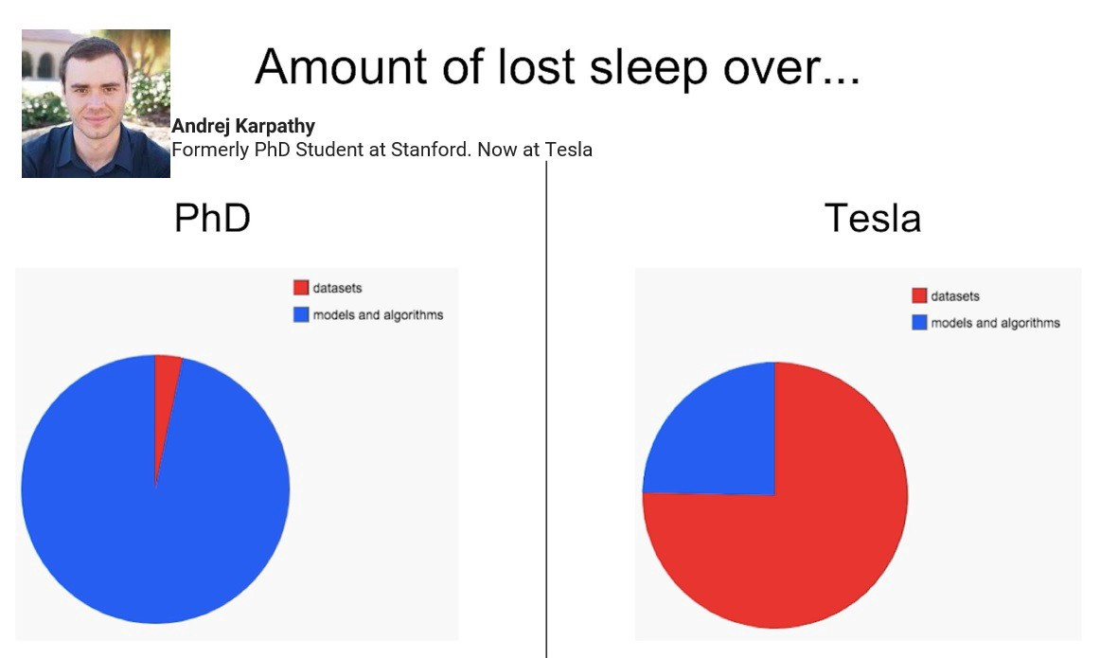
On Dataset Size and Learning
Data is a a resource! (e.g., like processors and memory)
Is having lots of processors a problem?
You don’t have to use all the data!
Though using more data can often help
More data often* dominates models and algorithms

Slide 13
Example: Scale is TPU’s Primary Value Proposition

Slide 14
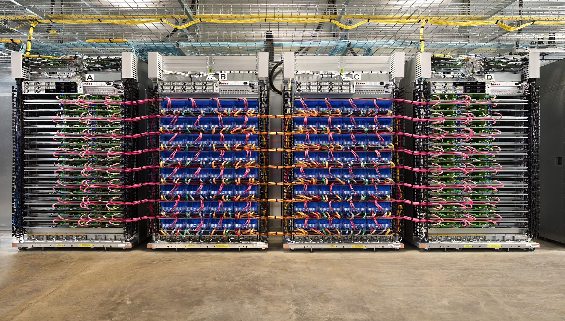
TPU Pod
64 2nd-gen TPUs
11.5 petaflops
4 terabytes of HBM memory

Slide 15
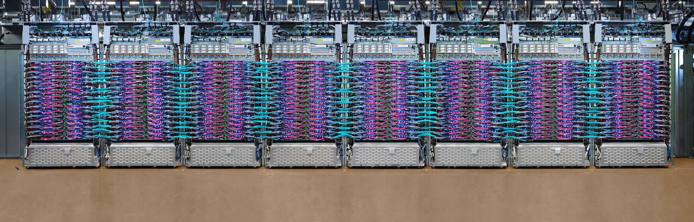
TPUv3
TPU v3

Slide 16
Ideal Metric of Success for Efficient Training
“Learning”
Second
“Learning” Record
Record
Second
=
x
Convergence
Machine Learning
Property
Throughput
System
Property
*Somewhat of a simplistic linear model. As we will later see there are many more moving parts to this

Slide 17
Metrics of Success
Minimize training time to “best model”
Best model measured in terms of test error
Other Concerns?
Complexity: Does the approach introduce additional training complexity (e.g., hyper-parameters)
Stability: How consistently does the system train the model?
Cost: Will obtaining a faster solution cost more money (power)?

Slide 18
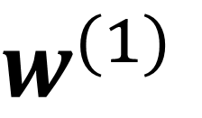
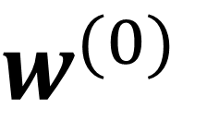

Gradient Descent
Learning rate
Two key elements:
The computed gradient: the direction
The learning rate: how big a step do we take?

Slide 19
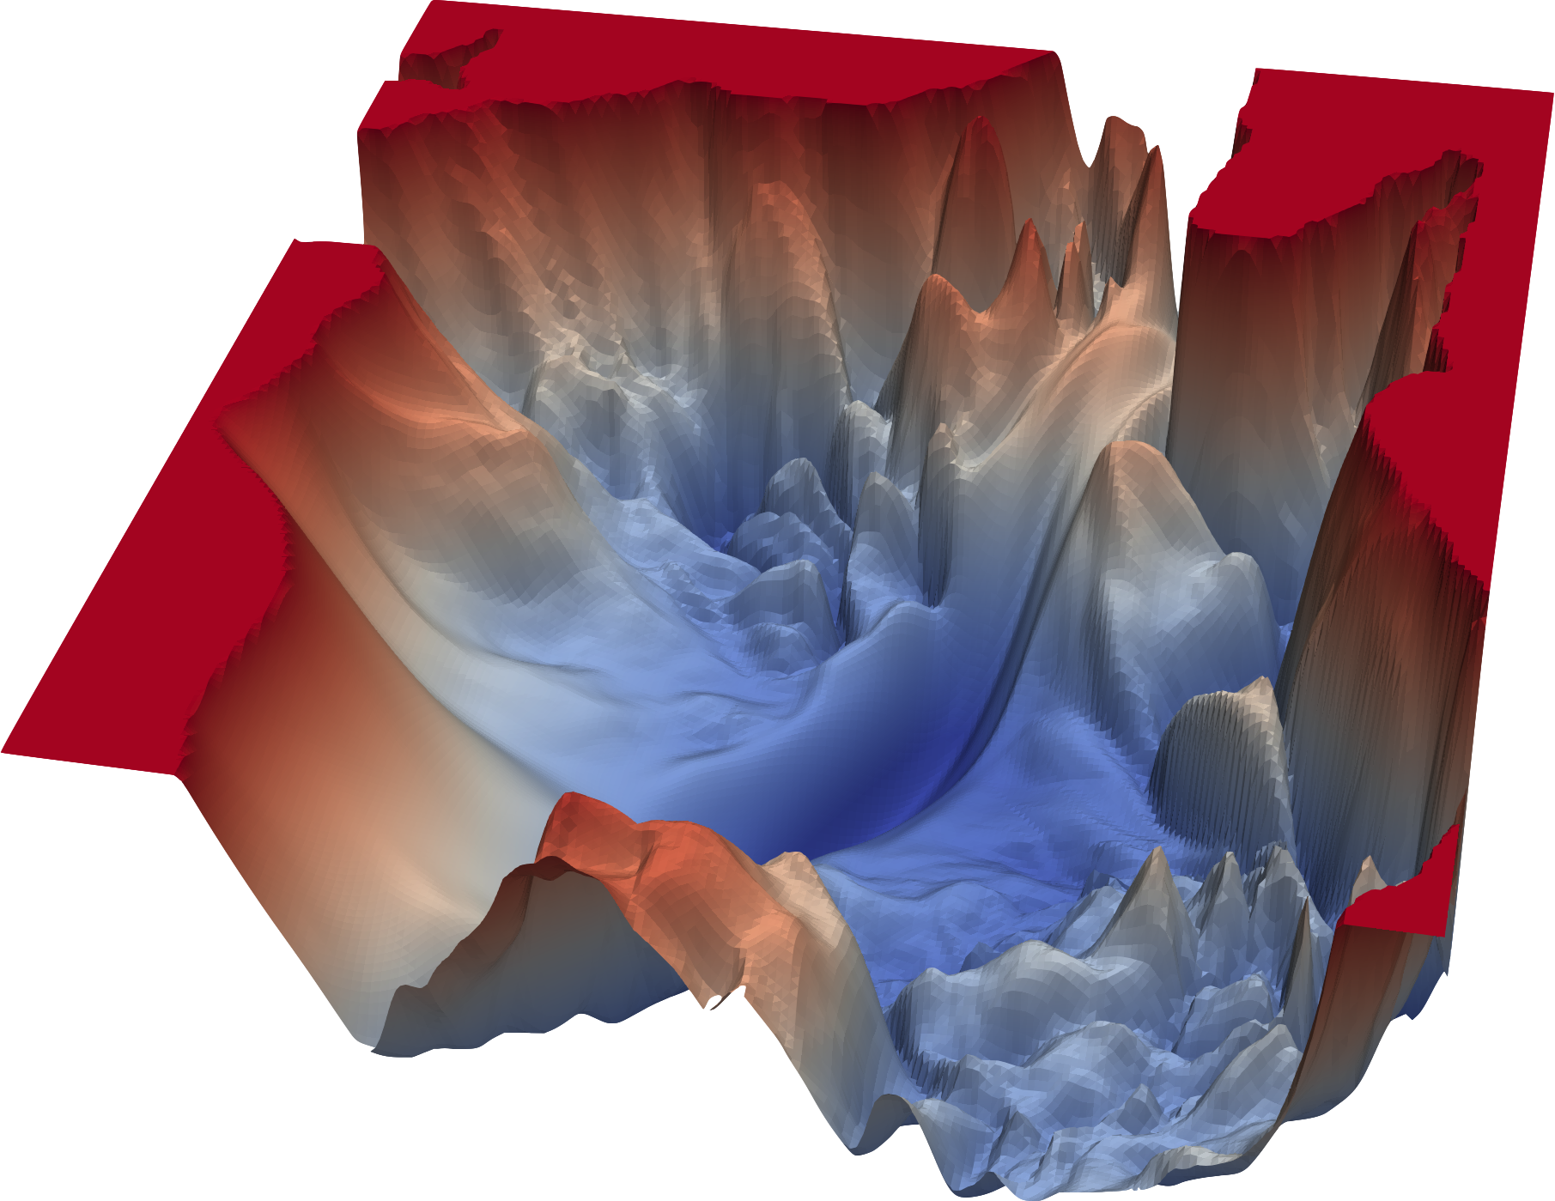
Stochastic Gradient Descent
Learning rate
Two key elements:
The computed gradient: the direction
The learning rate: how big a step do we take?

Slide 20

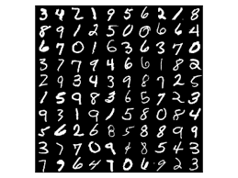
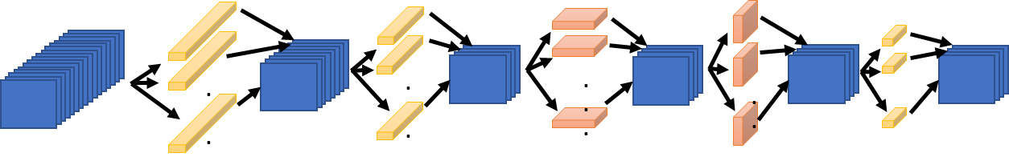
Synchronous Stochastic Gradient Descent
In every iteration of SGD we load a random mini-batch of training data, and compute the gradient.
GPU
Mini-batch
64
fprop
bprop

Slide 21
Parallelization Opportunities
Data Parallelism: Distribute the processing of data to multiple PEs.
Model Parallelism: Break the model and distribute processing of every layer to multiple PEs
For either approach it is also possible to use synchronous or asynchronous updates

Slide 22
Bulk Synchronous Parallel (BSP) Execution
Compute
Communicate
Compute
Machine 1
Iteration
Waste
Iteration
w
w¹
w
Machine 2
Iteration
Iteration
Waste
w
w²
w
Machine 3
Iteration
Waste
Iteration
w
w³
w
Barrier
Barrier

Slide 23
Bulk Synchronous Parallel (BSP) Execution
Compute
Communicate
Compute
Machine 1
Iteration
Waste
Iteration
Machine 2
Iteration
Iteration
Waste
Machine 3
Iteration
Waste
Iteration
Barrier
Barrier
Enable more frequent coordination on parameter values

Slide 24
Asynchronous Execution
Compute
Communicate
Compute
Machine 1
Iteration
Iteration
Machine 2
Iteration
Iteration
Machine 3
Iteration
Iteration
Enable more frequent coordination on parameter values, but often results in generalization loss. Today we will only focus on synchronous training.

Slide 25
Synchronous Data Parallel

Slide 26

Synchronous Data Parallelism
1024
Compute the entire model on each processor
Distribute the batch evenly across each processor:
1024 batch distributed over 16 PEs: 64 images per GPU
Communicate gradient updates through allreduce
GPU 1
GPU 2
GPU 3
GPU 16
64
64
64
64
fprop
fprop
fprop
fprop
…
bprop
bprop
bprop
bprop
MPI ALLREDUCE

Slide 27
All Reduce
GPU 1
GPU 2
GPU 3
GPU 4
MPI ALLREDUCE

Slide 28
All Reduce
There are many different all reduce algorithms, each with their own trade offs.
For simplicity, assume our model has 4 layers, and is trained on P=4 machines
Machine A
Machine B
a₁
a₂
a₃
a₄
b₁
b₂
b₃
b₄
Machine D
Machine C
d₁
d₂
d₃
d₄
c₁
c₂
c₃
c₄

Slide 29
All Reduce
Mechanism to sum and distribute data across machines.
Used to sum and distribute the gradient
Machine B
b₁
b₂
b₃
b₄
Parameter Server (Single Master All-Reduce)
Machine A
a₁
a₂
a₃
a₄
Machine D
Machine C
d₁
d₂
d₃
d₄
c₁
c₂
c₃
c₄

Slide 30
All Reduce
Mechanism to sum and distribute data across machines.
Used to sum and distribute the gradient
Machine B
Parameter Server
Machine A
Sends (P-1) * N Data
P Machines
N Parameters
a₁
a₂
a₃
a₄
b₁
b₂
b₃
b₄
c₁
c₂
c₃
c₄
d₁
d₂
d₃
d₄
Machine D
Machine C

Slide 31
All Reduce
Mechanism to sum and distribute data across machines.
Used to sum and distribute the gradient
Machine B
Parameter Server
Machine A
Sends (P-1) * N Data
P Machines
N Parameters
a₁
a₂
a₃
a₄
b₁
b₂
b₃
b₄
c₁
c₂
c₃
c₄
d₁
d₂
d₃
d₄
s_{i}
=
a_{i}
+
b_{i}
+
c_{i}
+
d_{i}
Machine D
Machine C

Slide 32
All Reduce
Mechanism to sum and distribute data across machines.
Used to sum and distribute the gradient
Machine B
Parameter Server
Machine A
Communicate (P-1) * N Data
P Machines
N Parameters
s₁
s₁
s₁
s₁
s₂
s₂
s₂
s₂
s₃
s₃
s₃
s₃
s₄
s₄
s₄
s₄
s_{i}
=
a_{i}
+
b_{i}
+
c_{i}
+
d_{i}
Machine D
Machine C

Slide 33
All Reduce
Mechanism to sum and distribute data across machines.
Used to sum and distribute the gradient
Machine B
Parameter Server
s₁
s₂
s₃
s₄
*2
Machine A
Communicate (P-1) * N Data
P Machines
N Parameters
s₁
s₂
s₃
s₄
s_{i}
=
a_{i}
+
b_{i}
+
c_{i}
+
d_{i}
Machine D
Machine C
s₁
s₂
s₃
s₄
s₁
s₂
s₃
s₄

Slide 34
All Reduce
Mechanism to sum and distribute data across machines.
Used to sum and distribute the gradient
*2
Parameter Server
Comm (P-1) * N Data
P Machines
N Parameters
Machine A
Machine D
Machine C
Machine B
Issues?
High fan-in on Machine A
(P-1) * N Bandwidth for Machine A

Slide 35
All Reduce
Mechanism to sum and distribute data across machines.
Used to sum and distribute the gradient
Machine A
Machine B
a₁
a₂
a₃
a₄
b₁
b₂
b₃
b₄
Parameter Server All Reduce
Machine D
Machine C
d₁
d₂
d₃
d₄
c₁
c₂
c₃
c₄

Slide 36
All Reduce
Mechanism to sum and distribute data across machines.
Used to sum and distribute the gradient
Machine A
Machine B
a₁
a₂
a₃
a₄
b₁
b₂
b₃
b₄
Send each entry to parameter server for that entry.
Key 1 → A
Key 2 → B
Key 3 → C
Key 4 → D
Machine D
Machine C
d₁
d₂
d₃
d₄
c₁
c₂
c₃
c₄

Slide 37
Machine A
Machine B
a₁
b₁
c₁
d₁
a₂
b₂
c₂
d₂
Each machine sends N/P data to all other machines.
(P-1) * N/P
P Machines
N Parameters
Machine D
Machine C
a₄
b₄
c₄
d₄
a₃
b₃
c₃
d₃

Slide 38
Machine A
Machine B
s₁
s₂
Compute local sum on each machine
s_{i}
=
a_{i}
+
b_{i}
+
c_{i}
+
d_{i}
Machine D
Machine C
s₄
s₃

Slide 39
Machine A
Machine B
s₁
s₁
s₁
s₂
s₂
s₂
s₁
s₂
Each machine broadcasts* the sum (N/P data size) to all other machines.
(P-1) * N/P
P Machines
N Parameters
Machine D
Machine C
s₄
s₄
s₄
s₄
s₃
s₃
s₃
s₃
* Technically All Gather based on MPI communication definition

Slide 40
Machine A
Machine B
s₁
s₂
s₃
s₄
s₁
s₂
s₃
s₄
Total Communication per machine:
2* (P-1) * N/P (roughly independent of P)
P Machines
N Parameters
Machine D
Machine C
s₁
s₂
s₃
s₄
s₁
s₂
s₃
s₄

Slide 41
Parameter Server All-Reduce
Same amount of total data transmitted as before, but spread evenly across all machines instead of just one
Same high fan-in (P-1)
Reduced Inbound Bandwidth = 2*(P-1)N/P
Previously 2*(P-1)*N for the parameter server
Machine A
Machine B
Machine D
Machine C

Slide 42
Machine A
Machine B
a₁
a₂
a₃
a₄
b₁
b₂
b₃
b₄
Ring All Reduce
Send messages in a ring to reduce fan-in.
Machine D
Machine C
d₁
d₂
d₃
d₄
c₁
c₂
c₃
c₄

Slide 43
Machine A
Machine B
a₂
a₃
a₄
b₁
b₃
b₄
d₄
a₁
← Note this depicts a partial sum and not a bigger message.
Ring All Reduce
Machine D
Machine C
d₁
d₂
d₃
c₁
c₂
c₄
c₃
b₂

Slide 44
Machine A
Machine B
a₂
a₃
b₃
b₄
d₃
a₄
c₃
d₄
Ring All Reduce
Machine D
Machine C
d₁
d₂
c₁
c₄
c₂
b₁
b₂
a₁

Slide 45
Machine A
Machine B
a₂
b₃
d₂
a₃
c₂
d₃
b₂
c₃
Ring All Reduce
Machine D
Machine C
d₁
c₄
c₁
b₄
b₁
a₄
a₁
d₄

Slide 46
Machine A
Machine B
s₃
s₃
s₃
s₂
s₃
s₂
s₂
s₂
Ring All Reduce
Each machine sends N/P data to next machine each of (p-1) rounds:
(P-1) * N/P (doesn’t depend on P!)
Fan-in Per Round:
1 (doesn’t depend on P)
Machine D
Machine C
s₁
s₁
s₁
s₁
s₄
s₄
s₄
s₄

Slide 47
Machine A
Machine B
s₃
s₃
s₃
s₂
s₃
s₂
s₂
s₂
Ring All Reduce
Broadcast stage* repeats process sending messages forwarding sums (same communication costs).
Machine D
Machine C
s₁
s₁
s₁
s₁
s₄
s₄
s₄
s₄
* Technically All Gather based on MPI communication definition

Slide 48
Machine A
Machine B
s₂
s₂
s₁
s₂
s₃
s₁
s₁
s₂
Ring All Reduce
Machine D
Machine C
s₁
s₄
s₄
s₄
s₃
s₄
s₃
s₃

Slide 49
Machine A
Machine B
s₁
s₁
s₂
s₃
s₂
s₄
s₁
s₄
Ring All Reduce
Machine D
Machine C
s₁
s₃
s₄
s₄
s₃
s₂
s₃
s₂

Slide 50
Machine A
Machine B
s₁
s₂
s₃
s₄
s₁
s₂
s₃
s₄
Ring All Reduce
Machine D
Machine C
s₁
s₂
s₃
s₄
s₁
s₂
s₃
s₄

Slide 51
Machine A
Machine B
s₁
s₂
s₃
s₄
s₁
s₂
s₃
s₄
Ring All Reduce
Machine D
Machine C
s₁
s₂
s₃
s₄
s₁
s₂
s₃
s₄

Slide 52
Ring All-Reduce
Simplified communication topology with low fan-in
Overall communication
Same total communication: 2*(P-1)*N, but evenly distributed
Each Machine communicates 2*(P-1)N/P (almost independent of P)
Fan-in is constant (doesn’t depend on P)
Issue: Number of communication rounds (P-1)
Machine A
Machine B
Machine D
Machine C

Slide 53
Double Binary Tree All-Reduce
Two overlaid binary reduction trees
Double the fan-in → Log(p) rounds of communication
Currently used on Summit super-computer and latest NCCL
https://devblogs.nvidia.com/massively-scale-deep-learning-training-nccl-2-4/

Slide 54
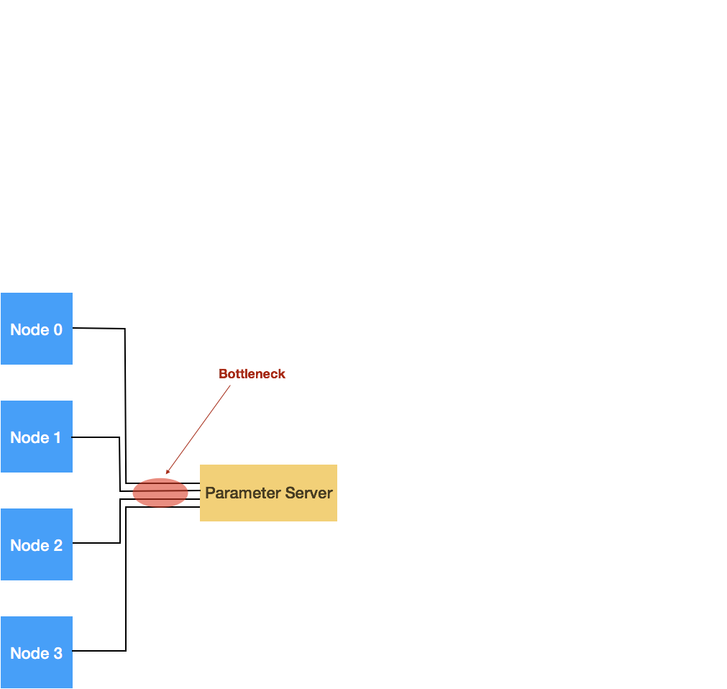
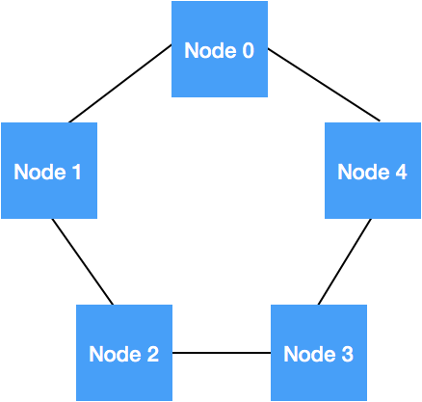
Complexity Summary
α latency
β bandwidth
N message size
P #processes
Parameter Server
Ring All-reduce
Great Reference: T. Rajeev, R. Rabenseifner, and W. Gropp. "Optimization of collective communication operations in MPICH." The International Journal of High Performance Computing Applications, 2005.

Slide 55
Data Parallel Training Complexity Analysis
Question: Comm time of ring allreduce is independent of the number of processors. So what limits scalability?
GPU
GPU
GPU
…
GPU

Slide 56
Limits of Data Parallel Scaling
The maximum limit of processors that you can use is P=B
But this often leads to very low utilization of the hardware and would not yield any speed up
Why does this happen?
Remember roofline model?
One epoch training time of AlexNet computed on an Intel KNL system

Slide 57
Limits of Data Parallel Scaling
The maximum limit of processors that you can use is P=B
But this often leads to very low utilization of the hardware and would not yield any speed up
One epoch training time of AlexNet computed on an Intel KNL system

Slide 58
Scaling Data Parallel Training
1024
If we want to keep scaling synchronous SGD then we have to keep increasing the batch size.
GPU 1
GPU 2
GPU 3
GPU 16
64
64
64
64
fprop
fprop
fprop
fprop
…
bprop
bprop
bprop
bprop
MPI ALLREDUCE

Slide 59
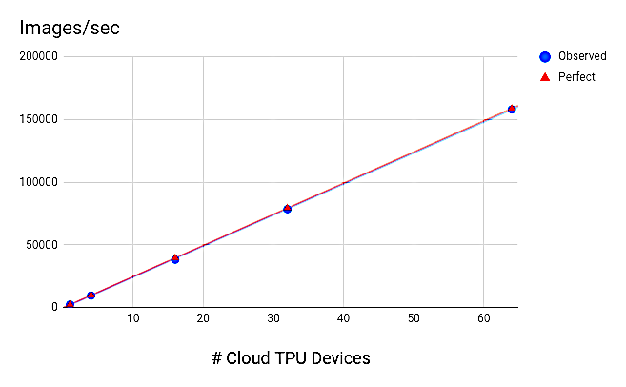
Naively increasing Batch size leads to perfect results but …

Slide 60
Bigger isn’t Always Better
Motivation for larger batch sizes
More opportunities for parallelism → but is it useful?
Recall (1/n variance reduction):
Is a variance reduction helpful?
Only if it let’s you take bigger steps (move faster)
Does it affect the final prediction accuracy?

Slide 61
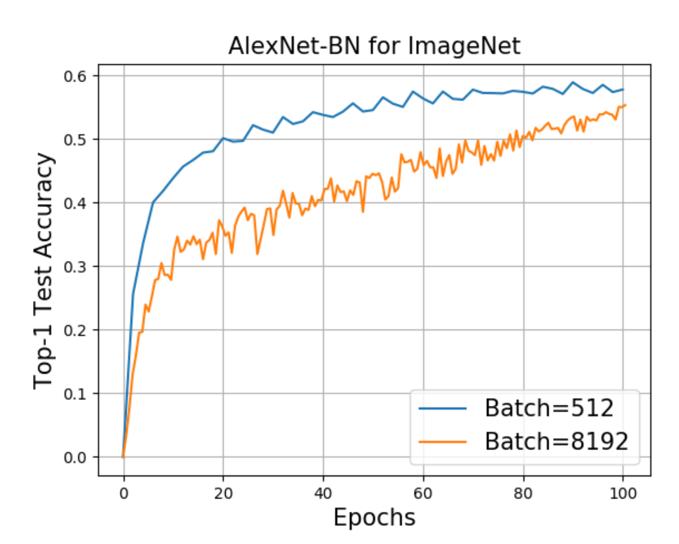
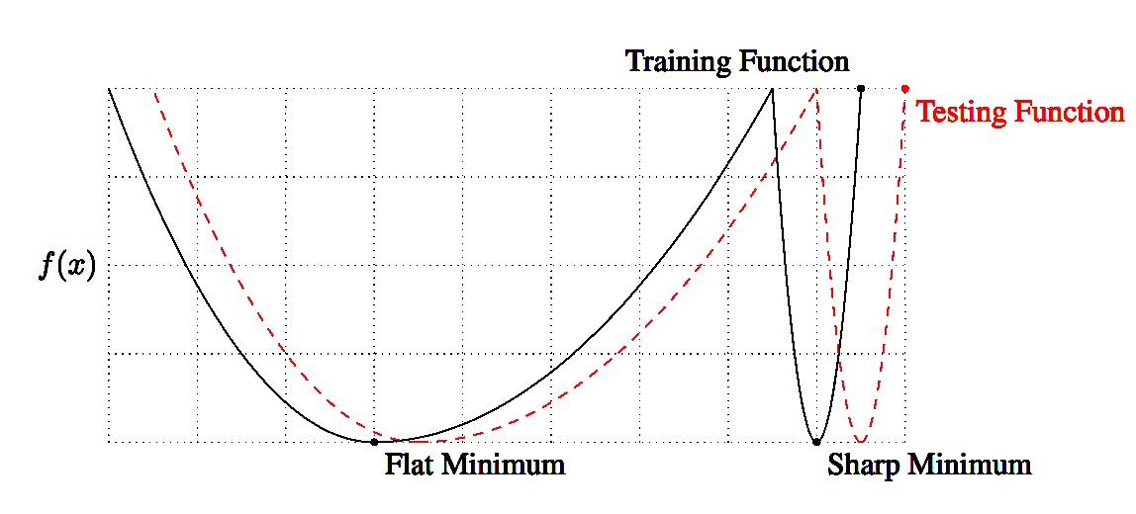
Problems with Large Batch Training
Larger Batch leads to sub-optimal generalization
A common belief is that large batch training gets attracted to “sharp minimas”
Keskar et al., On Large-Batch Training for Deep Learning: Generalization Gap and Sharp Minima, ICLR’16.
Z. Yao, A. Gholami, Q. Lei, K. Keutzer, M. Mahoney. Hessian-based Analysis of Large Batch Training and Robustness to Adversaries, NeurIPS’18.
Ginsburg, Boris, Igor Gitman, and Yang You. "Large Batch Training of Convolutional Networks with LARS." arXiv:1708.03888, 2018.

Slide 62
Generalization Gap Problem
Larger batch sizes harm generalization performance.

Slide 63
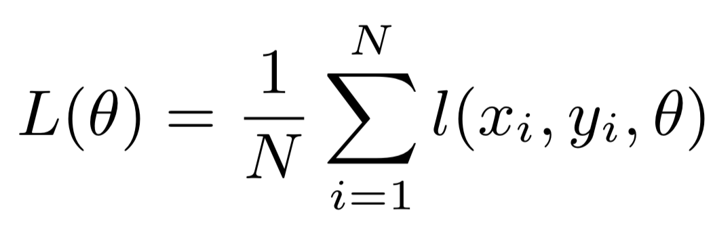
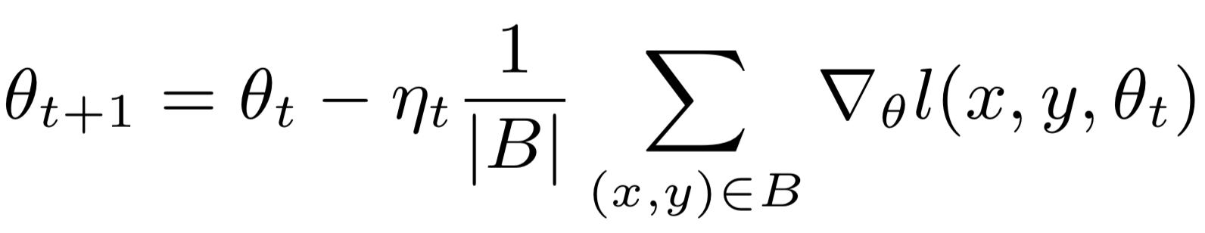
Why? Large Batch Reduces Noise and may Get Trapped in Local Minima
Objective function
Update rule
Small batch gradient descent acts as a regularizer
Loss
Sharp Minima Hypothesis
Parameter values along some direction
Active Research problem: Addressing the generalization gap for large batch sizes.

Slide 64
Solution: Linear Scaling Rule
Scale the learning rate linearly with the batch size
Addresses generalization performance by taking larger steps (also improves training convergence)
Sub-problem: Large learning rates can be destabilizing in the beginning. Why?
Gradual warmup solution: increase learning rate scaling from constant to linear in first few epochs
Doesn’t help for very large k…

Slide 65
Key Results
Training vs Validation
All curves closely match using the linear scaling rule.
Note learning rate schedule drops.

Slide 66
Key Results
“Learning” Epoch
Epoch
Second
Machine Learning
System

Slide 67
Key Results
Train ResNet-50 to state-of-the-art on 256 GPUs in 1 hour
90% scaling efficiency
Fairly careful study of the linear scaling rule
Observed limits to linear scaling do not depend on dataset size
But what is the limit?
You cannot indefinitely scale the learning rate …
Since then there has been a race to train ImageNet faster and several new large batch training methods have been developed (some with good foundation and some heuristics)

Slide 68

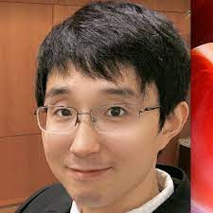


ImageNet Training Competition!
ImageNet is a dataset of 1.2M 224x224 images
Training 720 hours → <1 minute
Latest record:
14 seconds / TPUv4
(as of Feb 2022)
Iandola
Yang You
Iandola FN, Moskewicz MW, Ashraf K, Keutzer K. FireCaffe: near-linear acceleration of deep neural network training on compute clusters. In Proceedings of the IEEE Conference on Computer Vision and Pattern Recognition 2016 (pp. 2592-2600).
You Y, Zhang Z, Hsieh CJ, Demmel J, Keutzer K. Imagenet training in minutes. In Proceedings of the 47th International Conference on Parallel Processing 2018 Aug 13 (p. 1) ACM (Best Paper Award)

Slide 69
Very active area of research
Other papers to read if you are interested:
Golmant, Noah, et al. "On the computational inefficiency of large batch sizes for stochastic gradient descent” (Cal)
Shallue et al. “Measuring the Effects of Data Parallelism on Neural Network Training” (Google)
You, Yang, et al. "Large batch optimization for deep learning: Training bert in 76 minutes." (Cal)

Slide 70
Next week’s readings

Slide 71
Reading for Next Week
Chimera: Efficiently Training Large-Scale Neural Networks with Bidirectional Pipelines [SC’21, Best Student Paper finalist]
A novel technique for pipeline parallel training with bidirectional computational flow to reduce the ”bubble size”.
Efficient Large-Scale Language Model Training on GPU Clusters Using Megatron-LM [SC’21, Best Student Paper]
Large scale deployment of data, model, and pipeline parallelism to scale training of a 1T parameter transformer to 3K+ GPUs
ZeRO-Infinity: Breaking the GPU Memory Wall for Extreme Scale Deep Learning [SC’21]
A novel method for increasing the maximum size of the model that can be trained on a GPU by leveraging NVMe.

Slide 72
Extra Suggested Reading
DeepSpeed: Advancing MoE inference and training to power next-generation AI scale [Blog post]
Large Scale Distributed Deep Networks [NeurIPS’12]
One of the first papers using (known) techniques applied to training large ML models at Google
Gpipe: Efficient training of giant neural networks using pipeline parallelism [NeurIPS’19]
A micro-batching technique used for pipeline parallelism to reduce ”bubble size” with synchronous SGD
PipeDream: Fast and Efficient Pipeline Parallel DNN Training [SOSP’19]
Proposed an asynchronous method for reducing the ”bubble size” of pipeline parallel training

